Slide 1
Shell Access
Jens Mueller, PhD
HPC Services, Miami University

Slide 2
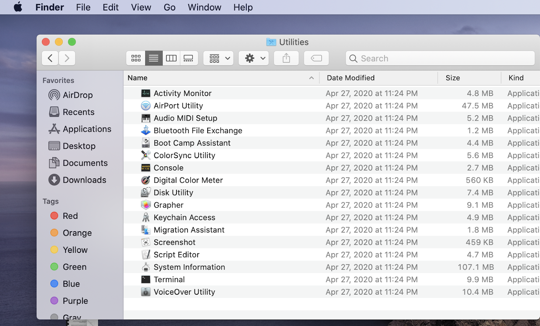
Mac terminal in Utilities folder

Slide 3
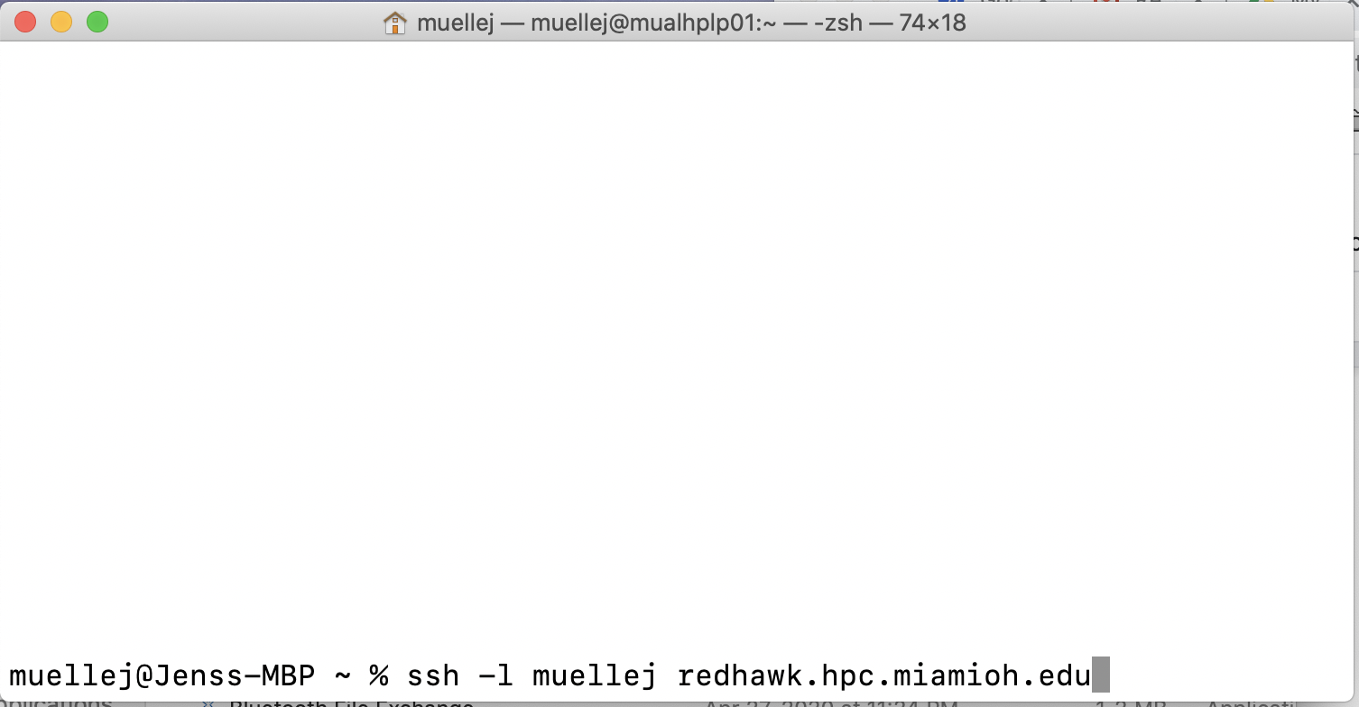
SSH is the standard access protocol

Slide 4
Login is via password and DUO, --or-- ssh keypairs
Most HPC sites user advanced authentication protocols these days
DUO is widely used at other HPC centers (Pittsburg Supercomputer Center PSC for instance)
SSH keypairs allows to skip both password and two-factor code authentication
SSH keypairs offers a comparable level of security to two-factor authentication
SSH keypairs requires a private key be present on the user’s client machine, needs different keys for different host machines

Slide 5
Dealing with Graphics applications
Requires X11 (graphics) environment be present on the client machine
X11 environments are platform specific: native to Linux(e.g. Ubuntu), Xming or MobaXterm for Win
XQuartz for MAC
XQuartz needs to be downloaded and installed

Slide 6
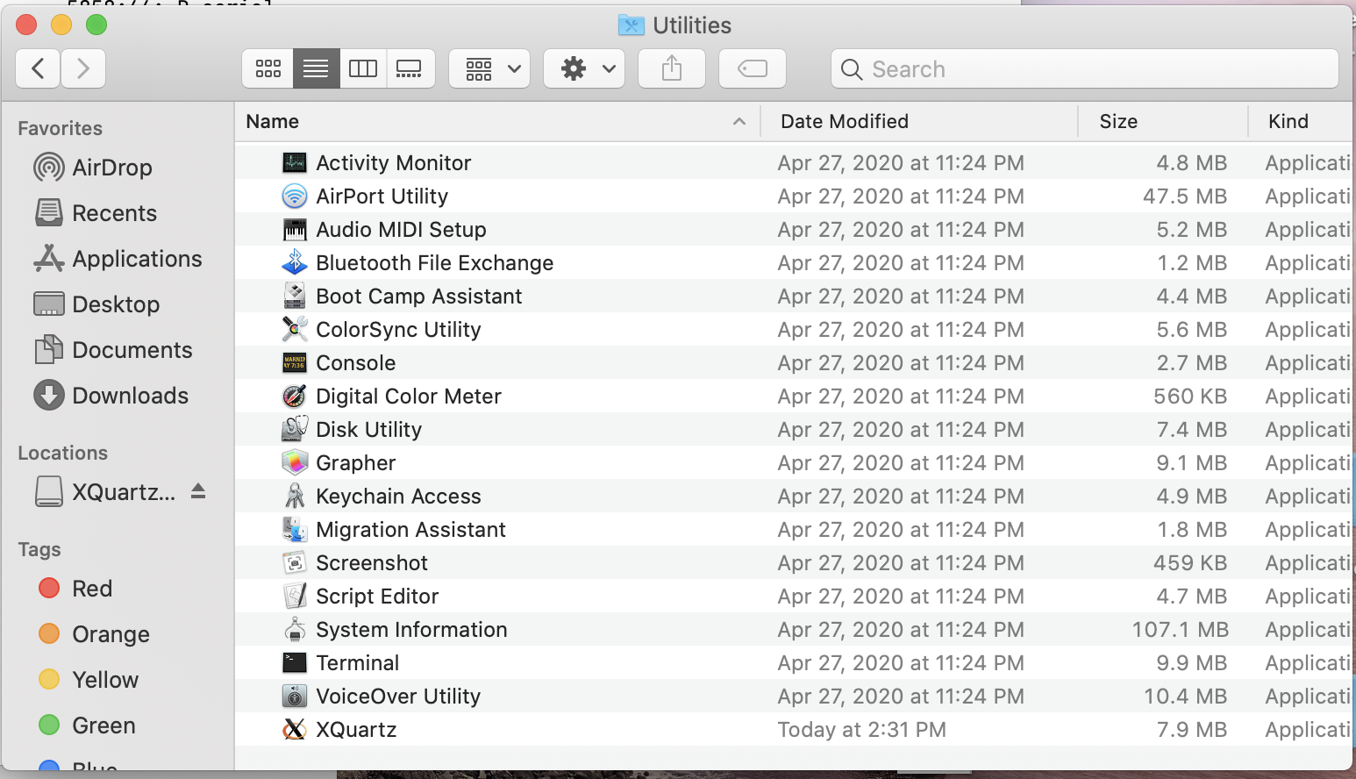
XQuartz on MAC
Start XQuartz and launch a terminal from “Applications”:
ssh -l muellej -X redhawk.hpc.miamioh.edu

Slide 7
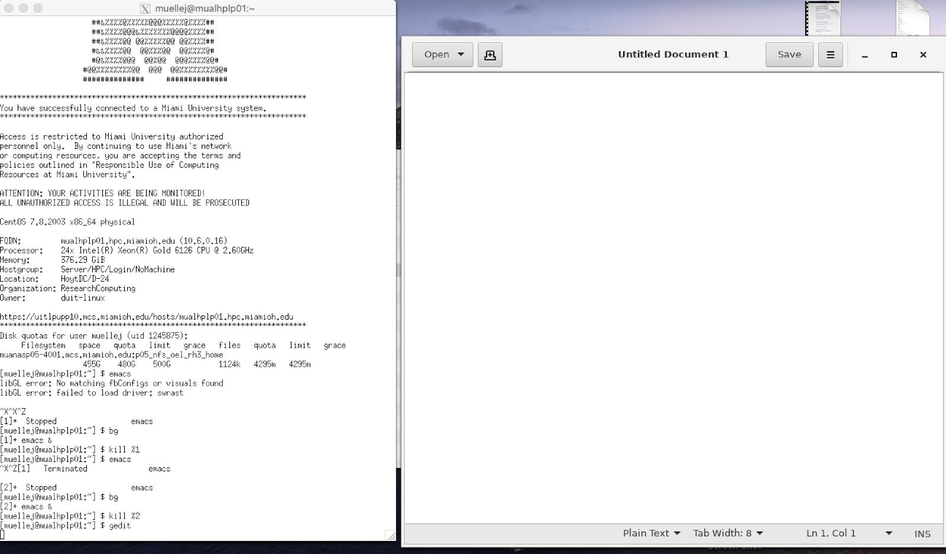
XQuartz on MAC
Launch an X11 application (gedit text editor)
Graphics forwarding can be slow, regardless of internet speed available. This may be due to the absence of compression algorithms.

Slide 8
SSH keypairs
SSH keypairs are a cryptographic system that can be universally used to avoid entering of passwords or two- factor code.
In a MAC terminal, type:
ssh-keygen -t rsa
This should generate two files in your .ssh directory on your Mac:
In the (note the .) $HOME/.ssh/ directory:
id_rsa and id_rsa.pub
id_rsa is the private key file and
id_rsa.pub is the public key file.
The public key in the file id_rsa.pub needs to go into the file
authorized_keys
in the $HOME/.ssh/ directory in your cluster home directory.

Slide 9
SSH keypairs
Logging in to the cluster from your client machine
Client machine has the private key
ssh protocol authenticates you by comparing the private key on the client with the public key on the host.
No password or DUO code is required

